Slide 1
Action for Youth
Krits – Finnish Foundation for Supporting Ex-offenders
Notes:
Hi I’m Mirja Salo and I come from here, from Finland. I work in Krits, wich stands for Finnish Foundation for Supporting Ex-offenders. I have been the project manager in action for youth.

Slide 2

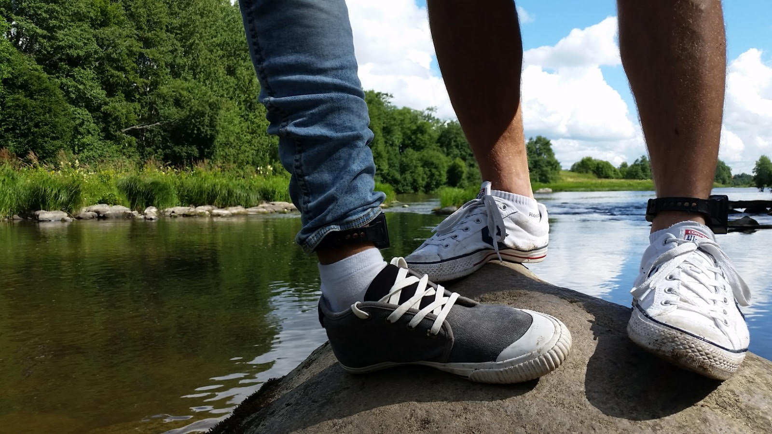
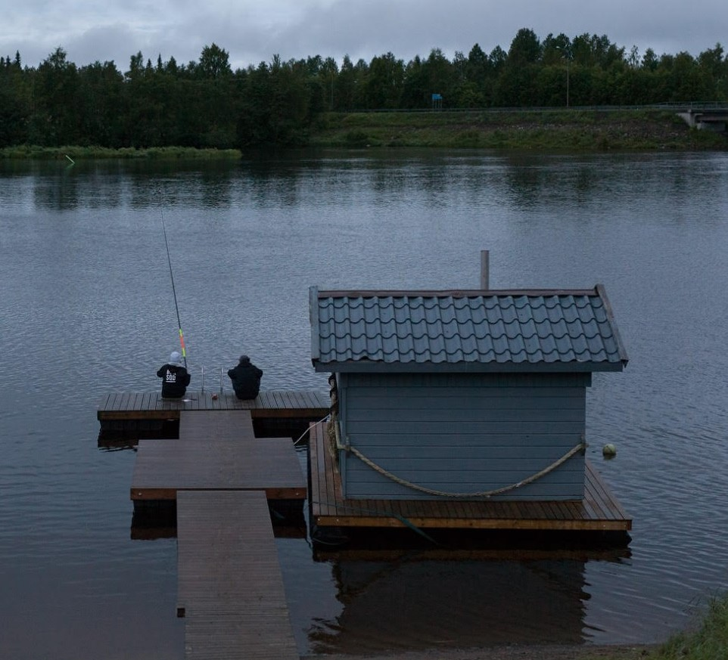
Krits is a non-governmental organisation that provides services to ex-offenders, their close ones, and professionals. It also acts nation-wide as an expert and activist in the field.
Action for Youth –project 2016-2019. The purpose has been to come up with new ways of reaching and supporting young offenders, prisoners and young people with criminal backgrounds. Aged between 15-29 years old. In 2018-2019 estimated 74% of the clients’ sanctions are to do with drug using or trafficing.
Funded by STEA Funding Centre for Social Welfare and Health Organisations
Notes:
Myself and Kimmo Gustafsson have developed this project in cooperation with several stakeholders of which Criminal sanctions agency is the most significant. At the moment, we are the only ones in Finland to provide such a support to this target group.
The age.. In Finland person under 15 years of age is not concidered by a court and the person is not sentenced to a punishmen. And the upper age comes from the youth law.
The hole project is founded by STEA.

Slide 3
Reducing recidivism
Contributing to over generational exclusion
Provide support for the transitional phase between imprisonment and the release to prevent relapses
Supporting recovery and motivation to change
Building and supporting new identity
Sober content for everyday life
Support towards abstinence or moderate use of intoxicants
Inform
Reach, engage and commit the clients to cooperate
Start building trust
Supporting recovery
Recovery
New identity
Desistance
Imprisonment
Juvenile punisment
Community sanctions
Freedom and liberated
Supervised probationary freedom
Monitoring sentence
- - - - - - - - - - - - - - -
- - - - - - - - - - - - - - -
Control & support
Subsidized employment
Cooperation with Criminal Sanctions Agency
Peer, individual and group support
Activities e.g. making music
Psychosocial support and conversations
Taking part in an individual sentence plan and preparation of release
Safe and intoxicant community and activity centre
Peer, individual and group support
Activities e.g. sports, field trips, music, podcast, camps, combat training
Life management skills e.g. cooking and cleaning
Wrap around support
Housing
Psychosocial support and conversations (Motivational interviewing)
RECOVERY ORIENTATION POSITIVE CRIMINOLOGY AND PSYCHOLOGY EMPOWERMENT
Notes:
TUOMIOT JA YHTÈISTYÖ NUOLI The main challenge amongst different organisations working with this target group, has been how to reach and engage the clients to ones activities and support. With the sanctions, it has been great success to combine the controll from Criminal sanctions agency to the support that we provide. Because our clients are executing sanctions, they are sober. This gives us time to empower and encourage clients in their recovery. The main challenge is motivation and making that stronger is the key. The recovery comes naturally after that. Approxmately a little bit more than 70% of the clients come through this cooperation.
VIITEKEHYKSET Frame of reference. In short terms, we want to see the good factors in our clients, so we can make them stronger and not to pay attention to the negative factors
VANKILAMENETELMÄT These are the methods we use inside prisons
VANKILATAVOITTEET And we aim to… We structure our methods around intrests of the clients and prison workers in order to develop cooperation, wich will in turn develope trust between service user and provider.
SIVIILIN TAVOITTEET The methods that we use in civil. It doesn’t matter so much what kind of activities we do, with all of them we aim to same goals. Approx 65% have participated or have been in contact with us atleast three times during this year.
TUKITYÖLLISTÄMINEN Subsidized employment like six months placement, is one way to support identity change. Providing a new way to see oneself as a part of society.
SIVIILIN TAVOITTEET Over all purpose of all activities is participation and inclusion.
PIKKU TAVOITTEET Sub targets are individual targets that take time to develop. We follow the guidelines of SMART goals to achieve new identities.
PÄÄTAVOITE And the main objective is reducing reoffending and prevent social exclusion for generations to come for the benefit of the local communities.

Slide 4

Mirja Salo
Project manager/ responsible counselor
mirja.salo@krits.fi
Tel. +358 50 412 4039
https://www.krits.fi/foundation-for-supporting-ex-offenders-in-english/
Facebook:
KRITS – Nuorten toimintakeskus
Krits Mirja Salo
Instagram:
kritsnuoret
Thank you!

